Slide 1
College Technical Math 1
Unit 9 Problems

Slide 2
Unit 9
17.1: Lines and Angles
17.2: Polygons
17.3: Circles and Radians
17.4: Volume and Surface Area

Slide 3

Circles
A circle is the set of all points equidistant from a fixed point (center).
Diameter (d) – straight line segment from one side of the circle to the other through the center
Radius (r)
Center
Diameter (d)
Radius – straight line segment from one side of the circle to the center; ½ the diameter
$$D=2r$$

Slide 4

Circles
Circumference:
(Perimeter)
$$C=πd=2πr$$
Radius
Center
Diameter

Slide 5



Circles
Circumference:
(Perimeter)
$$C=πd=2πr$$
Radius
Center
$$=π(6 in.)$$
$=18.85 in.$
Diameter
= 6 in.
(rounded)

Slide 6
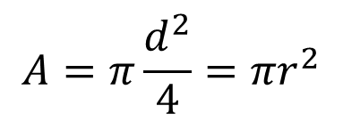
Circles
Area:
$$A=π\frac{d^{2}}{4}=πr^{2}$$
Radius
Center
Diameter

Slide 7

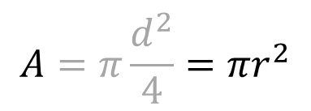

Circles
Area:
$$A=π\frac{d^{2}}{4}=πr^{2}$$
Radius
= 3 in.
Center
$$=π{(3 in.)}^{2}$$
Diameter
$$=28.27 in2$$
(rounded)

Slide 8



Composite Figures
Perimeter:
𝜋d
$$P=6 in. + 4 in. +6 in. + \frac{1}{2}\left(π(4 in.)\right)$$
$$=16 in+6.28 in$$
(rounded)
6 in.
$$=22.28 in$$
6 in.
(rounded)
4 in.

Slide 9




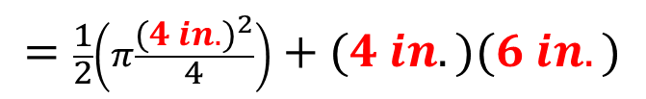
Composite Figures
Area:
A₁
$$A=A1+A2$$
$$=\frac{1}{2}\left(π{\frac{d}{4}}^{2}\right)+LW$$
6 in.
$$=\frac{1}{2}\left(π\frac{{(4 in.)}^{2}}{4}\right)+(4 in.)(6 in.)$$
A₂
6 in.
$=6.28 in2+24 in2$
(rounded)
4 in.
$$=30.28 in2$$
(rounded)

Slide 10
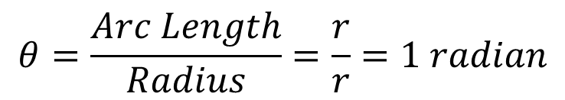

Degrees & Radians
1 radian - the measure of the central angle (θ) of a circle whose arc length is equal to the radius
r
θ
= 1 radian
r
$$θ=\frac{Arc Length}{Radius}=\frac{r}{r}=1 radian$$
$$1 radian≈57.3o$$

Slide 11
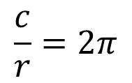

Degrees & Radians
Note that:
r
r
$$C=2πr$$
r
$$\frac{c}{r}=2π$$
θ
This means the radius could me marked off 2𝜋 (6.28...) times around the circle.
r
r
r

Slide 12
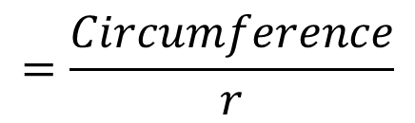
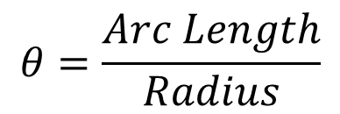
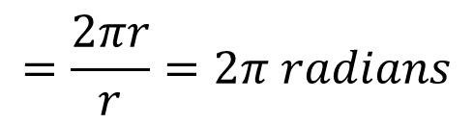
Degrees & Radians
For a complete circle:
$$θ=\frac{Arc Length}{Radius}$$
r
θ
$$=\frac{Circumference}{r}$$
$$=\frac{2πr}{r}=2π radians$$

Slide 13




Degrees & Radians
90º =$\frac{1}{2}$𝜋 rad
For a complete circle:
Therefore...
$$2π radians=360o$$
180º =𝜋 rad
0
or...
360º =
2𝜋 rad
$$π radians=180o$$
270º =$\frac{3}{2}$𝜋 rad

Slide 14
Degrees & Radians
O
O

Slide 15

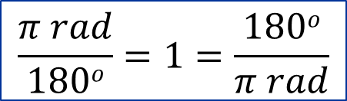

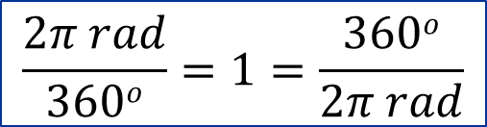
Degrees & Radians
90º =$\frac{1}{2}$𝜋 rad
Degrees ⟺Radians
$$2π radians=360o$$
$$\frac{2π rad}{360o}=1=\frac{360o}{2π rad}$$
180º =𝜋 rad
0
360º =
2𝜋 rad
or...
$$π radians=180o$$
$$\frac{π rad}{180o}=1=\frac{180o}{π rad}$$
270º =$\frac{3}{2}$𝜋 rad

Slide 16
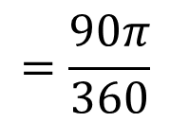


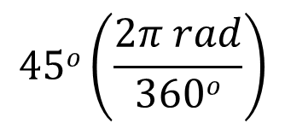
Degrees & Radians
90º =$\frac{1}{2}$𝜋 rad
Ex: Convert 45º to rad
$$45o\left(\frac{2π rad}{360o}\right)$$
$$=\frac{90π}{360}$$
180º =𝜋 rad
0
$$=\frac{π}{4} rad$$
360º =
2𝜋 rad
$$=0.785 rad$$
(rounded)
270º =$\frac{3}{2}$𝜋 rad

Slide 17
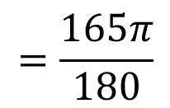

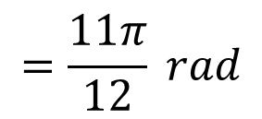
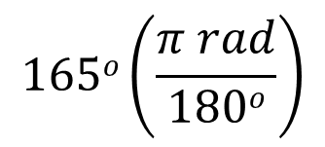
Degrees & Radians
90º =$\frac{1}{2}$𝜋 rad
Ex: Convert 165º to rad
$$165o\left(\frac{π rad}{180o}\right)$$
$$=\frac{165π}{180}$$
180º =𝜋 rad
0
$$=\frac{11π}{12} rad$$
360º =
2𝜋 rad
$$=2.88 rad$$
(rounded)
270º =$\frac{3}{2}$𝜋 rad

Slide 18

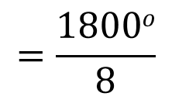


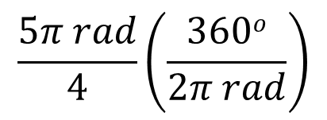
Degrees & Radians
90º =$\frac{1}{2}$𝜋 rad
Ex: Convert $\frac{5π}{4}$ rad to degrees
$$\frac{5π rad}{4}\left(\frac{360o}{2π rad}\right)$$
$$=\frac{1800o}{8}$$
180º =𝜋 rad
0
$$=225o$$
360º =
2𝜋 rad
270º =$\frac{3}{2}$𝜋 rad

Slide 19
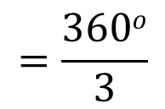


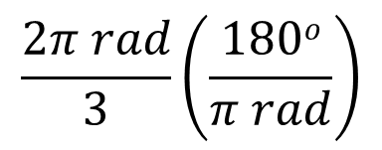
Degrees & Radians
90º =$\frac{1}{2}$𝜋 rad
Ex: Convert $\frac{2π}{3}$ rad to degrees
$$\frac{2π rad}{3}\left(\frac{180o}{π rad}\right)$$
$$=\frac{360o}{3}$$
180º =𝜋 rad
0
$$=120o$$
360º =
2𝜋 rad
270º =$\frac{3}{2}$𝜋 rad

Slide 20
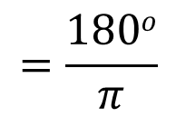

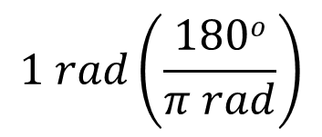
Degrees & Radians
90º =$\frac{1}{2}$𝜋 rad
Ex: Convert 1 rad to degrees
$$1 rad\left(\frac{180o}{π rad}\right)$$
$$=\frac{180o}{π}$$
180º =𝜋 rad
0
$$=57.3o$$
360º =
2𝜋 rad
(rounded)
270º =$\frac{3}{2}$𝜋 rad

